Slide 1
Edu Tutor Ai: Personalized Learning

Slide 2
INTRODUCTION
Topic:
edu tutor ai : personalized learning
Team leader:
Dhanalakshmi. K
Team mates:
sharmila. J
Pushpa. K

Slide 3
ABSTRACT
Education is undergoing a rapid transformation with the integration of Artificial Intelligence (AI). Traditional classrooms often struggle to meet the diverse needs of students because a single teaching method cannot suit every learner. Edu Tutor AI is a proposed intelligent tutoring system that offers personalized learning paths, real-time feedback, and adaptive content delivery. By leveraging AI, Machine Learning (ML), Natural Language Processing (NLP), and Data Analytics, the system enhances engagement, reduces learning gaps, and provides continuous progress tracking. This document presents a structured overview of Edu Tutor AI, highlighting its features, technologies, benefits, challenges, and future directions.
:

Slide 4
INTRODUCTION
Learning is most effective when it is tailored to individual needs. In conventional education systems, teachers handle large groups of students, often with different backgrounds, learning styles, and speeds. As a result, some students find lessons too easy, while others struggle to keep up. Personalized learning has emerged as a solution to this issue, focusing on customizing instruction based on student performance and preferences.
Artificial Intelligence plays a critical role in enabling such personalization. Edu Tutor AI combines adaptive algorithms, data-driven insights, and interactive tools to create a dynamic learning environment. It empowers students to learn at their own pace, helps teachers identify gaps quickly, and provides parents with clear visibility into their child’s progress.

Slide 5
PROBLEM STATEMENT
Despite advancements in education, several challenges remain:
Lack of individual attention – Teachers cannot give one-on-one guidance to every student in a large classroom.
2. Difficulty tracking performance – Manually monitoring student growth is time-consuming and error-prone.
3. One-size-fits-all teaching – The same content is delivered to all, ignoring different skill levels.
4. Low engagement – Students often lose interest in rigid, non-interactive lessons.
5. Limited resources – Schools with fewer teachers struggle to provide personalized support.

Slide 6
SOLUTION OVERVIEW
Edu Tutor AI is designed as a smart tutoring system that adapts dynamically to each learner. The system collects data from student interactions, analyzes performance using AI/ML algorithms, and provides customized content. For example, if a student struggles with algebra, the system provides extra practice and hints, while advanced students can move ahead without delay.
The solution ensures:
Students always receive appropriate challenges.
Feedback is instant and constructive.
Learning materials are personalized to style (visual, auditory, practical).
Parents and teachers get detailed reports.
Support is available 24/7 via chatbot or mobile app.

Slide 7
KEY FEATURES
Adaptive Learning Paths
The system adjusts lesson difficulty and pace based on real-time student performance.
Real-Time Feedback
Mistakes are identified instantly, and hints are offered before moving to the next concept.
Content Personalization
Edu Tutor AI recommends videos, examples, and exercises tailored to individual learning preferences.
Progress Tracking
Detailed dashboards track growth over time, highlighting weak and strong areas.
24/7 Availability
Students can access lessons anytime, making learning more flexible.

Slide 8
TECHNOLOGY USED
Artificial Intelligence & Machine Learning:
Power adaptive algorithms.
Natural Language Processing (NLP):
Understands student queries and provides relevant answers.
Data Analytics:
Analyzes learning patterns and predicts areas needing improvement.
Chatbots/Virtual Assistants:
Provide instant help and reminders.
Cloud Platforms:
Store data securely and enable global access.

Slide 9
IMPLEMENTATION PLAN
1. Requirement Gathering – Understand student, teacher, and institutional needs.
2. Prototype Development – Build a small-scale model with limited subjects.
3. Pilot Testing – Conduct trials with a group of students and collect feedback.
4. Iteration & Improvement – Refine algorithms and content.
5. Full-Scale Deployment – Launch system for schools, colleges, and self-learners.

Slide 10
BENEFITS
For Students:
Increases motivation, reduces exam anxiety, ensures mastery of concepts.
For Teachers:
Automates repetitive tasks, highlights struggling students, saves teaching time.
For Parents:
Provides clear reports and insights into learning progress.
For Institutions:
Improves academic performance, reduces dropout rates, and enhances reputation.

Slide 11
CHALLENGES
Data Privacy & Security – Protecting student data is critical.
Over-dependence on AI – Students must still develop independent problem-solving skills.
Accessibility – Digital divide may limit use in rural/low-resource areas.
Fairness & Bias – AI must avoid biased recommendations based on incomplete or skewed data.

Slide 12
FUTURE SCOPE
Edu Tutor AI has potential for significant expansion:
Immersive Learning (VR/AR): Students can explore virtual labs or historical sites.
Emotion-Aware Tutors: AI can adapt responses based on student moods or stress levels.
Multilingual Support: Teaching in regional languages to reach global learners.
Hybrid Models: Seamless integration with classroom teaching to support blended learning.

Slide 13
CONCLUSION
Edu Tutor AI represents the next step in modern education. By combining adaptive learning, real-time feedback, and personalized resources, it creates a student-centered environment where every learner gets the support they need. The system not only benefits students but also empowers teachers, informs parents, and strengthens institutions. While challenges like data privacy and accessibility remain, ongoing improvements and ethical safeguards can address them. With further development, Edu Tutor AI could redefine how knowledge is delivered and mastered in the 21st century.

Slide 14
REFERENCE
Journal of Artificial Intelligence in Education.
2. EdTech Research Reports (2024).
3. UNESCO Reports on AI in Education.
4. Online resources on Adaptive Learning Systems.
5. Reports on Personalized Learning and Digital Classrooms .

Slide 15
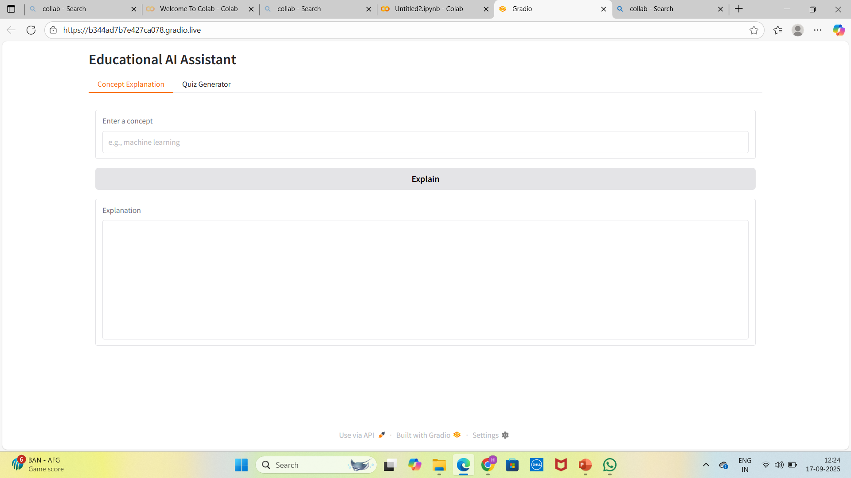
SCREENSHOT

Slide 16
